Slide 1

DevOps Fundamentals
Serhii Chernukha
TDF02

Slide 2
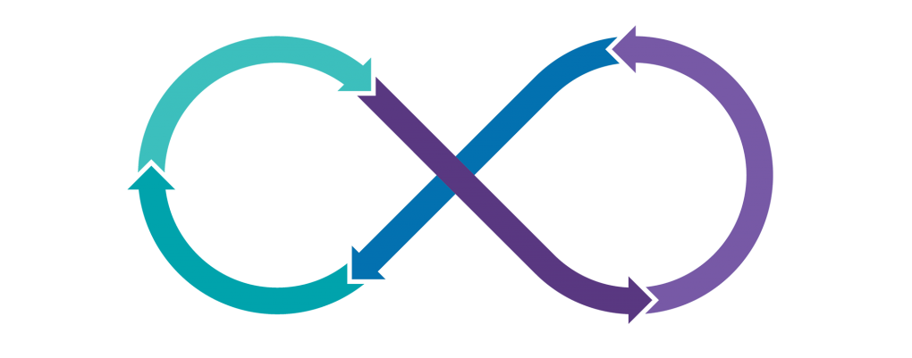

Version Control System (Git)

Slide 3

AGENDA
Introduction
Version Control Systems
Git (Basic Overview)
- Installation & Configuration
- Local operations
- File status lifecycle
- Push and Pull
- .gitignore
Branch creating
Adding tags
Merge & Rebase processes
Git Flow

Slide 4
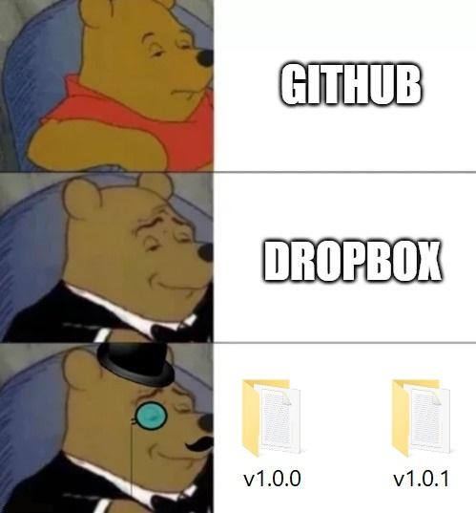



INTRODUCTION
?

Slide 5
CVCS
SERVER
Centralized Version Control System
Version_3
Version_2
Version_1
UC-1
UC-2
Files
Files

Slide 6
DVCS
SERVER
Distributed Version Control System
Version_3
Repository
Version_2
Version_1
UC-1
UC-2
Version_3
Version_3
Version_2
Version_2
Version_1
Version_1

Slide 7
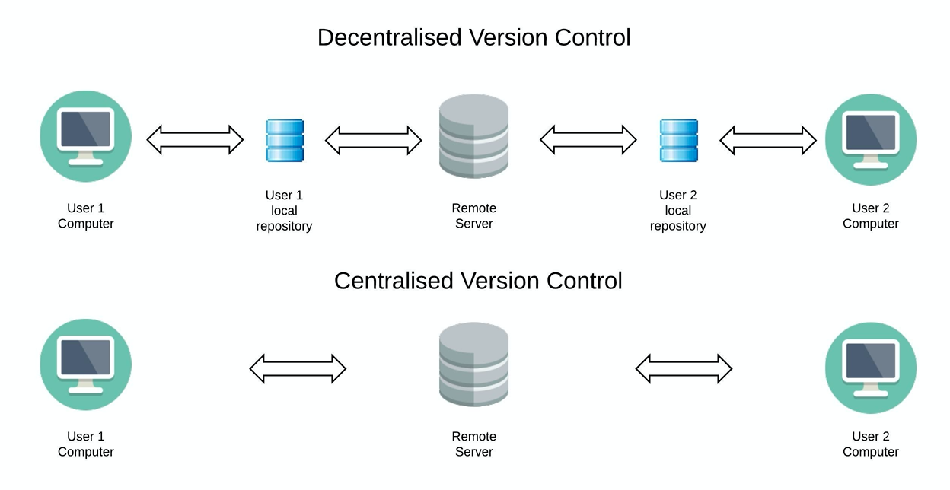
CVCS VS DVCS

Slide 8
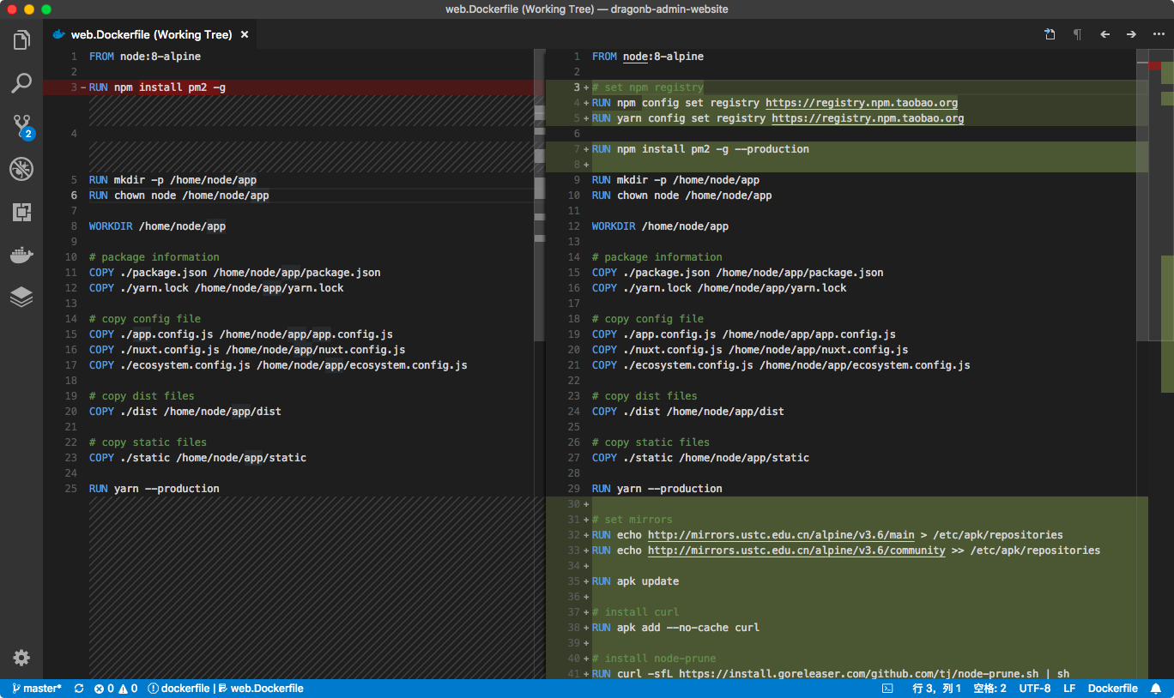
VCS
diff

Slide 9
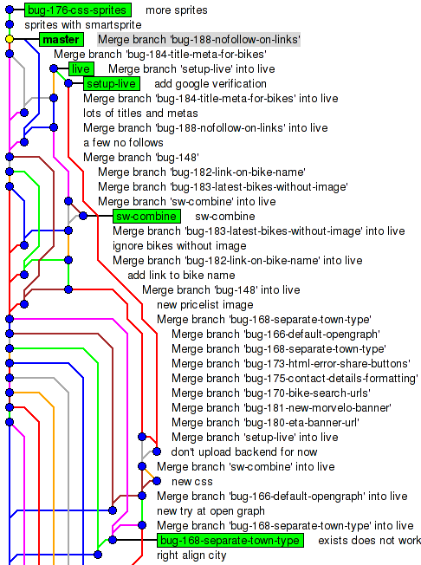
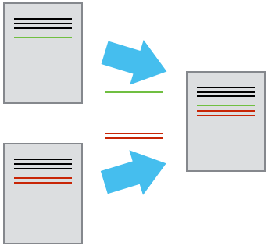
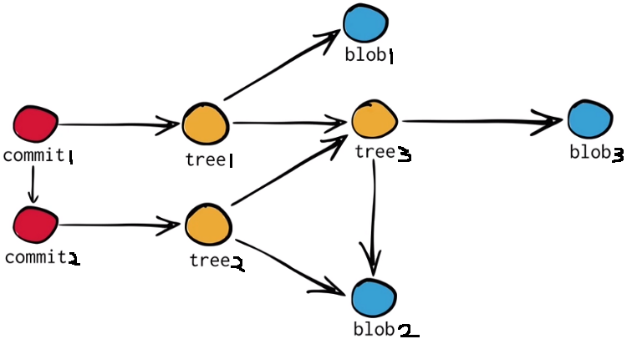
VCS(Git)

Slide 10

Git

Slide 11
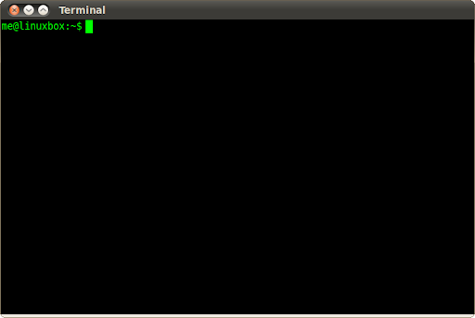



Git installation
LINUX Command line
Gitbash
#Fedora (RHEL, Centos)
sudo dnf install git-all
#Debian (Ubuntu)
sudo apt install git

Slide 12

Git configuration
git config
#Config file location
--global use global config file
--system use system config file
--local use repository config file

Slide 13
Git configuration
git init
#Initialize the project
git clone
HTTPS https://github.com/user/repository.git
SSH git@github.com:user/repository.git

Slide 14
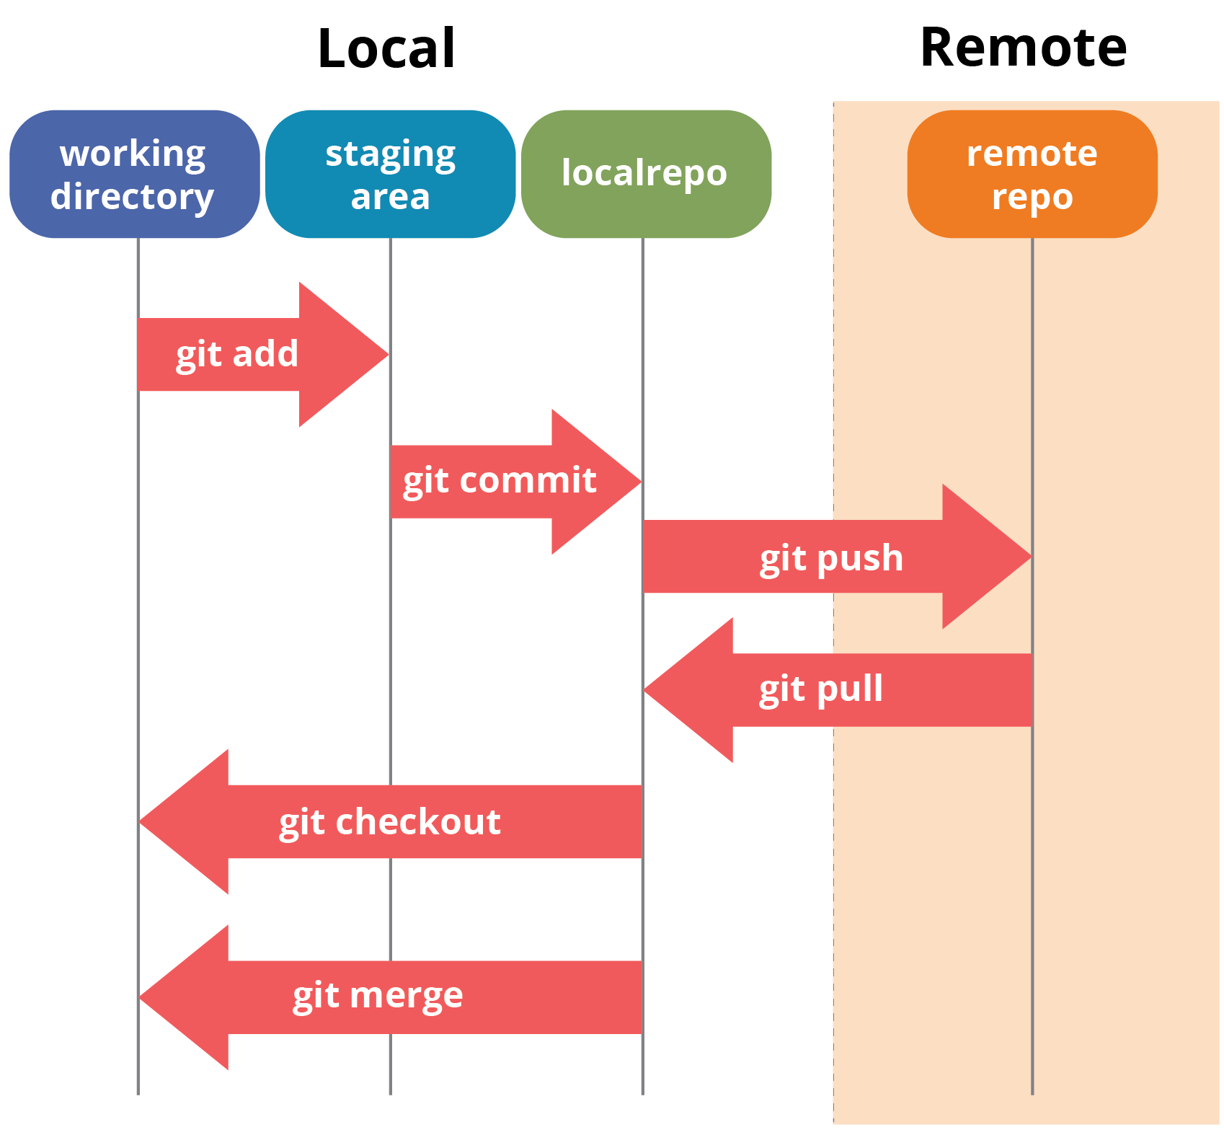
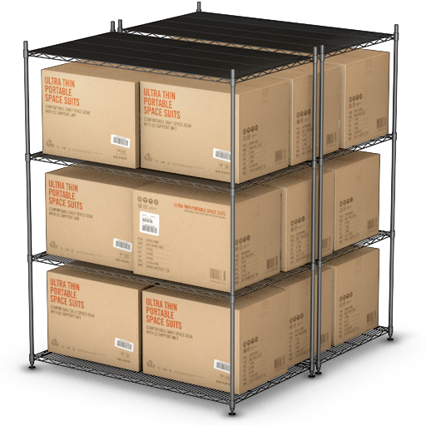


Git Local Operations

Slide 15
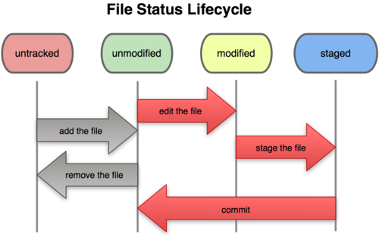
Git FSL

Slide 16
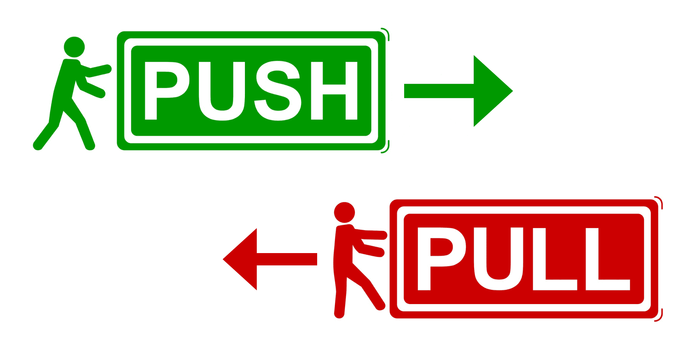
Push & Pull

Slide 17
Push & Pull

Slide 18
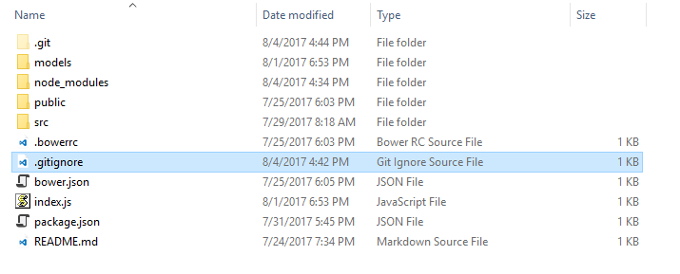
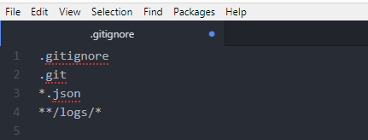
.gitignore

Slide 19
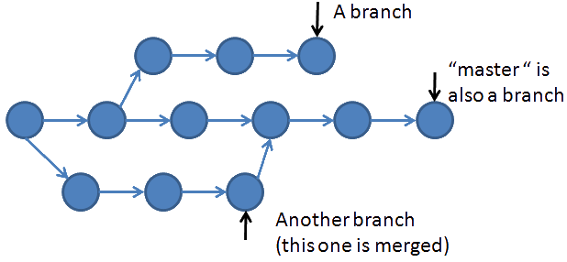
Branch creating
git branch ‘name’
git checkout -b ‘name’
git checkout ‘name’

Slide 20
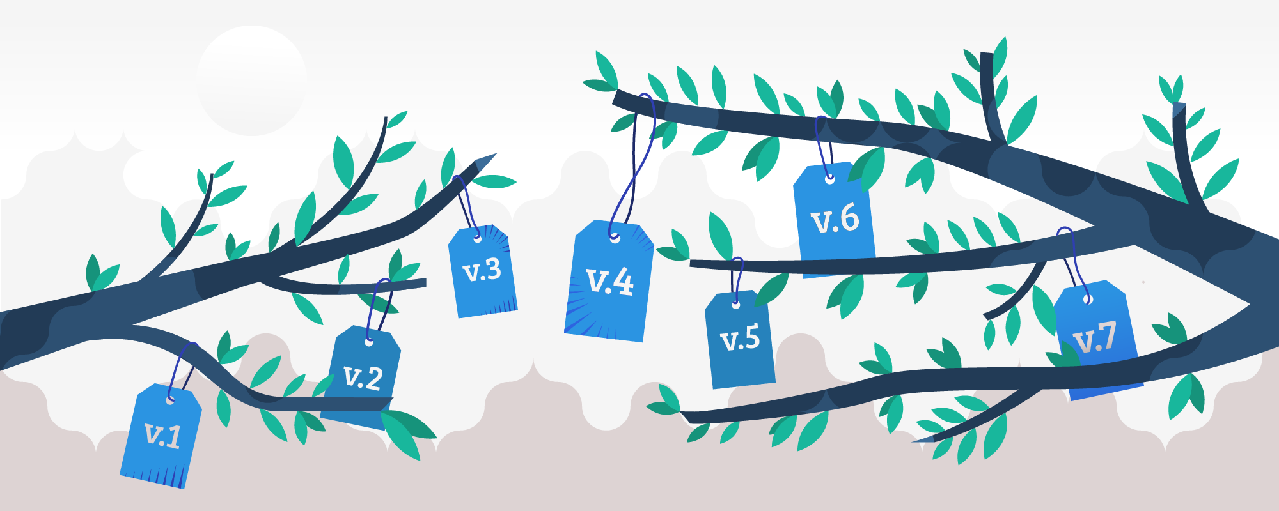
Git Tags

Slide 21
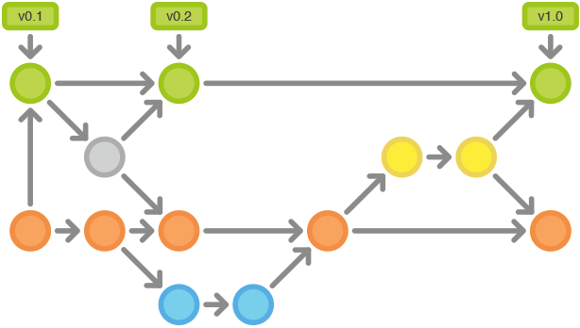
Git Tags

Slide 22
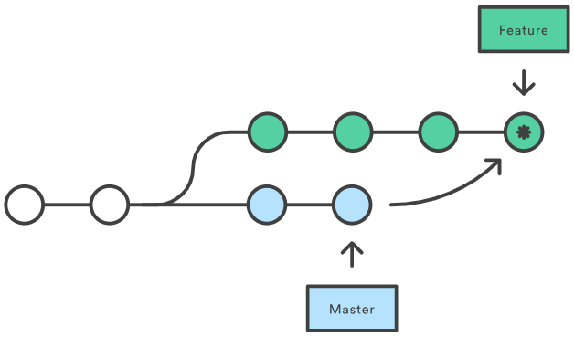
Merge & Rebase processes
git merge

Slide 23
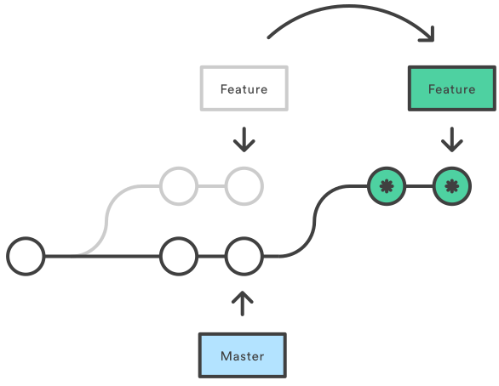
Merge & Rebase processes
git rebase

Slide 24
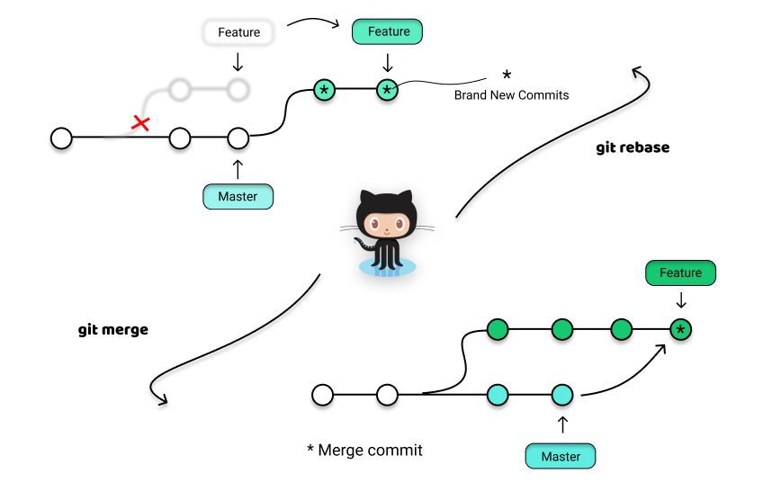
Merge & Rebase processes

Slide 25
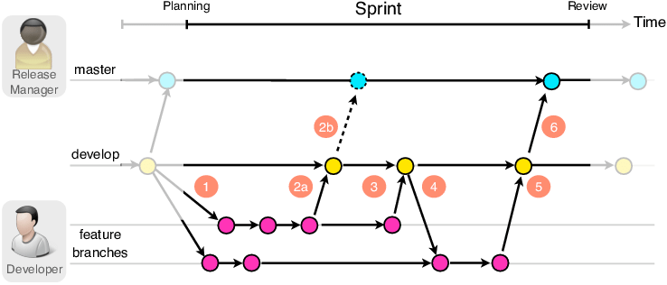
Git Flow

Slide 26
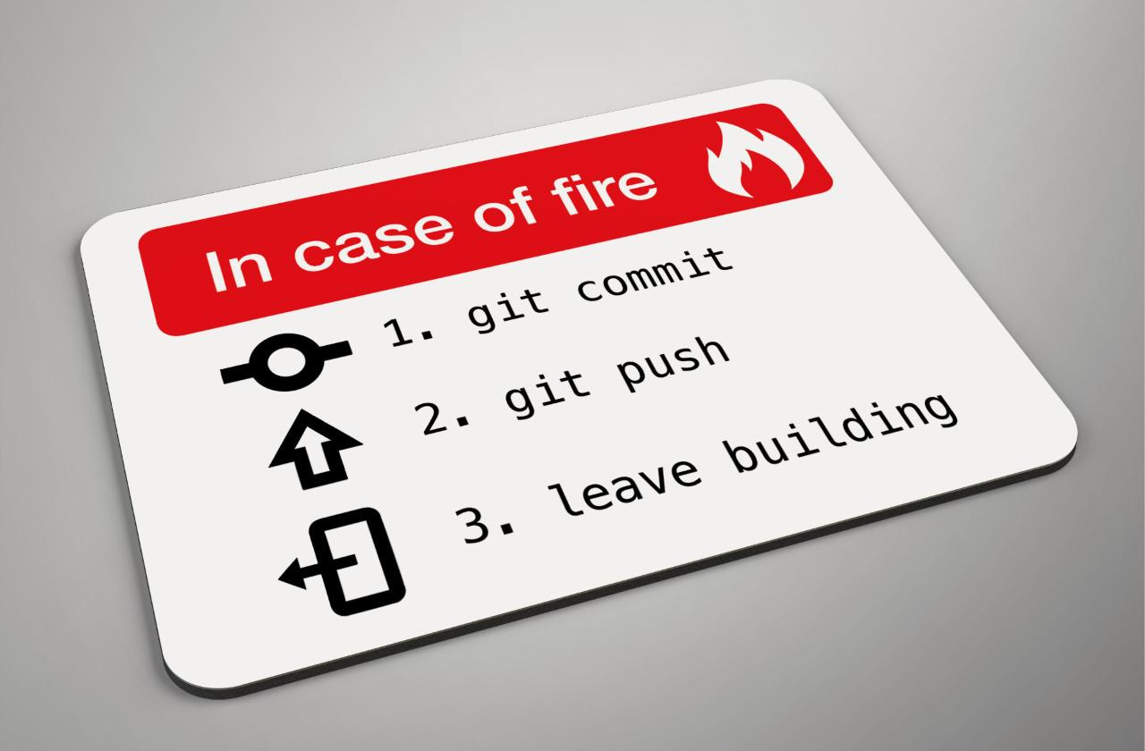

Git Flow

Slide 27



Git Services

Slide 28

DEMONSTRATION

Slide 29

Useful links:
https://git-scm.com/book/en/v2/Getting-Started-About-Version-Control
https://usersnap.com/blog/software-development-methodologies/
https://git-scm.com/book/ru/v2/
https://htmlacademy.ru/blog/useful/tools/github-as-hosting
https://habr.com/ru/post/106912/

Slide 30

Thank You

